Slide 1

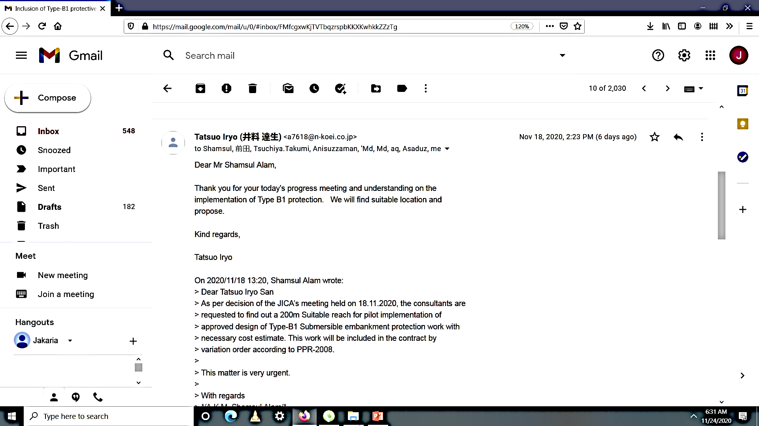
JICA’S APPRECIATION

Slide 2
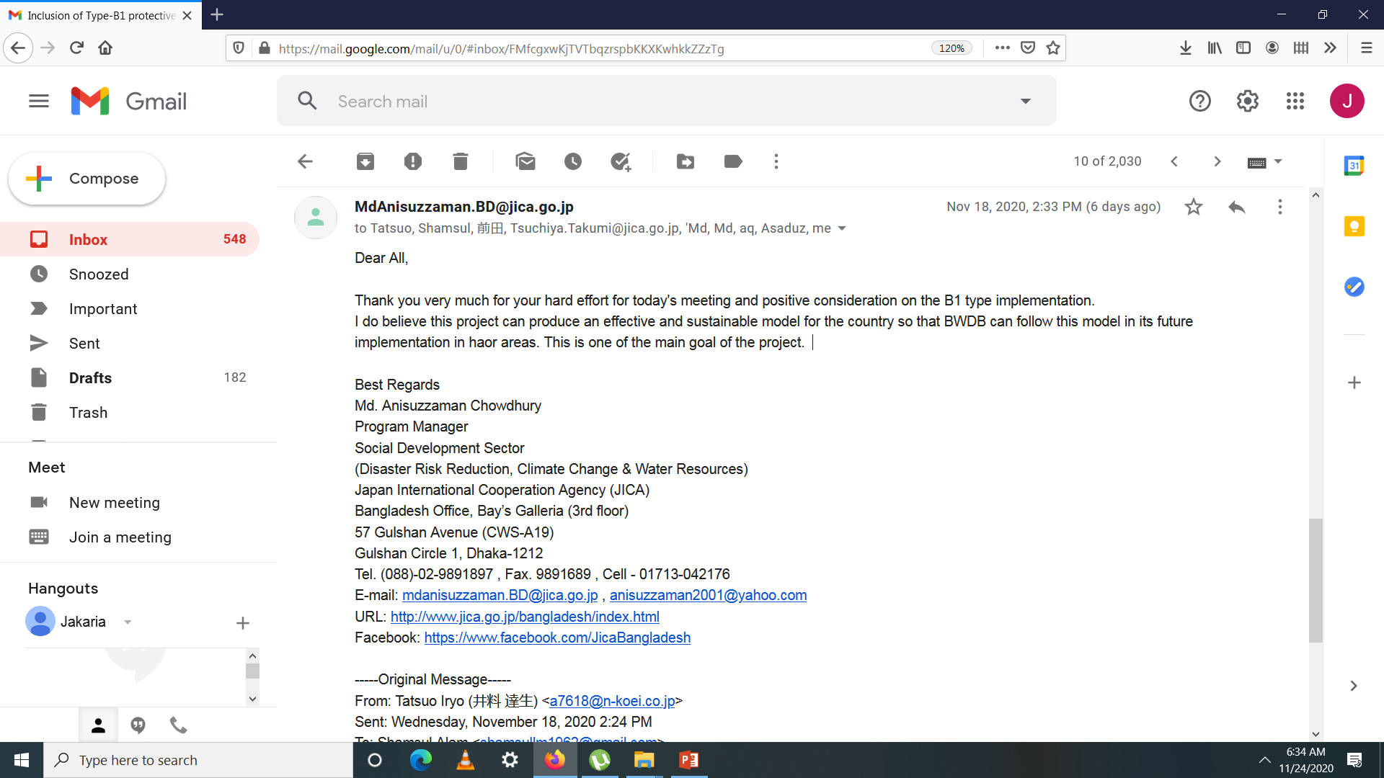
JICA’S APPRECIATION

Slide 3
WHY DID WE GET APPRECIATION

Slide 4
WHY DID WE GET APPRECIATION
For Accurate Representation of Flood Situation in the project area(Damage)
For Representation and Explaining in detail of Design of different type of protection work.
For Presentation of Activity plan for civil works next two dry seasons
Progress in agriculture component and plan for next FY
Presentations of civil works monitoring format

Slide 5
Work Program for 2020-21

Slide 6
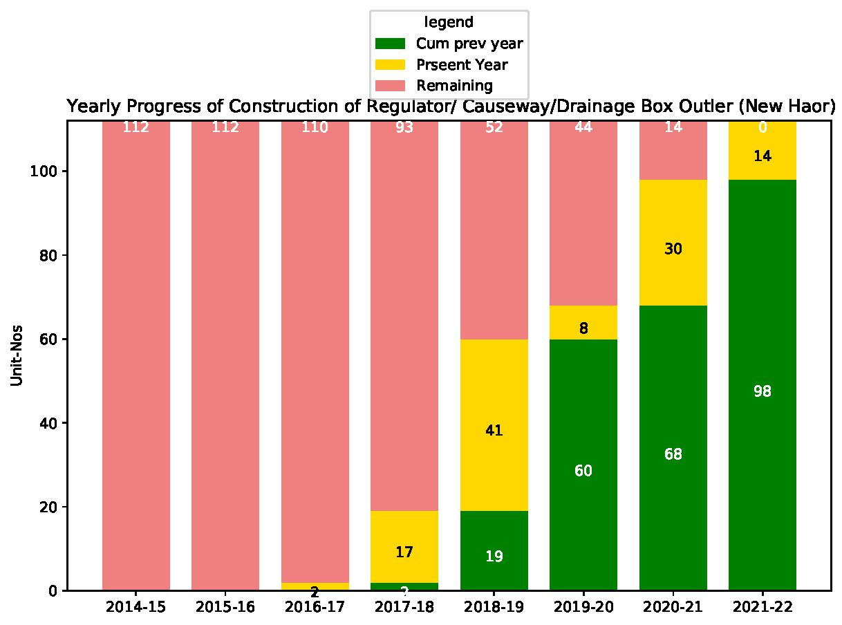
Activity Plan for Next TWO Years?

Slide 7
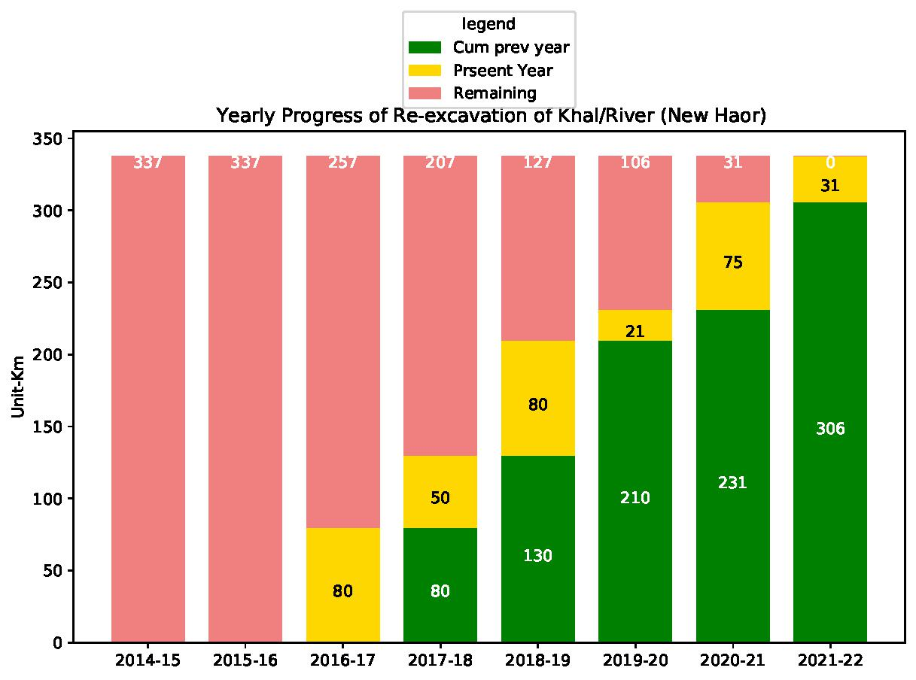
Progress of Re-excavation of Khal/River (New Haor)

Slide 8
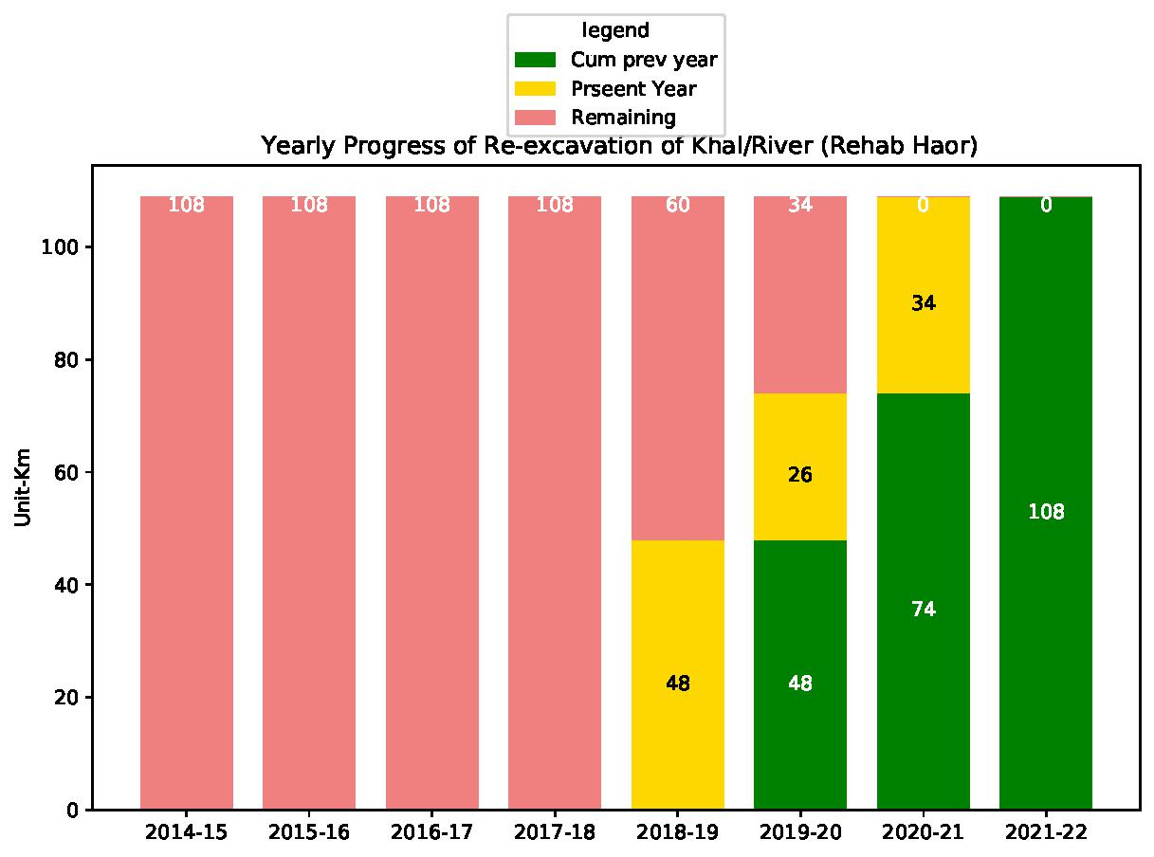
Progress of Re-excavation of Khal/River (Rehab Haor)

Slide 9
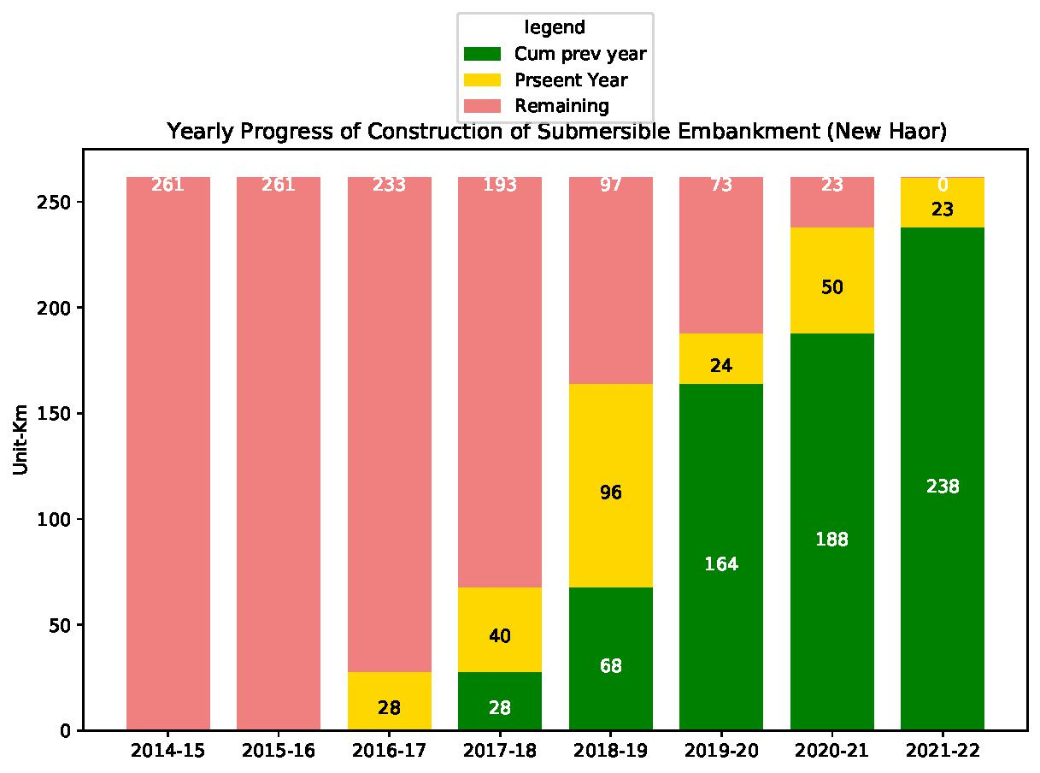
Progress of Construction of Submersible Embankment (New Haor)

Slide 10
Yearwise Civil Works Expenditure

Slide 11
Activity Plan for Next TWO Years?

